Slide 1


GUJARAT TECHNOLOGICAL UNIVERCITY
Vishwakarma Government Engineering CollageRT
EXPENSE MANAGER
Name Internal Faculty Guide
PARGI SUNILKUMAR LALSINGBHAI DIPAK PATEL

Slide 2
Table of Content
Abstract
Introduction
Literature Survey/Research
Study of Current System
Problems/Weakness/Improvement needed in Current System
Features of Proposed System
Object Oriented Diagrams (Use Case, Sequence, Activity, Class, Flow - whichever is applicable)
Wireframe (if applicable)
Tools and Technologies used
Worked carried out till date
Timeline Chart(Gantt chart)
Future Work & Conclusion
References

Slide 3
Abstract
Personal finance management is an important part of people’s lives. However, everyone does not have the knowledge or time to manage their finances in a proper manner. And, even if a person has time and knowledge, they do not bother with tracking their expenses as they find it tedious and time-consuming. Now, you don’t have to worry about managing your expenses, as you can get access to an expense manager known as expense manager that will help in the active management of your finances.
In this Expense manager user can create its profile also can use image for profile image. User can add expenses with various categories and subcategories by adding more details. He/She can also get receipts by adding expenses which occurs in a list and can be also used as receipts. In expense form which is provided user can upload its existing receipts that can be saved for future purposes.
In the same user can manage income by adding details like its currency and transaction type i.e. credit, cash etc. By this at the user will get its budget that can be used after income and expenses done from it.

Slide 4
Introduction
Expense management refers to the process of tracking, analyzing, and ultimately controlling business spending. It encompasses a variety of tasks, from recording receipts to preparing expense reports. For small businesses and new finance managers, mastering this discipline can be the key to keeping your company's finances in check.
An Expense manager is a web app that helps to keep an accurate record of your money inflow and outflow. Many people in India live on a fixed income, and they find that towards the end of the month they don’t have sufficient money to meet their needs. While this problem can arise due to low salary or due to poor money management skills.
In this website user can create its profile also can use image for profile image. User can add expenses with various categories and subcategories by adding more details. He/She can also get receipts by adding expenses which occurs in a list and can be also used as receipts. In expense form which is provided user can upload its existing receipts that can be saved for future purposes.
In the same website user can manage income by adding details like its currency and transaction type i.e. credit, cash etc. By this at the user will get its budget that can be used after income and expenses done from it.

Slide 5
Contents in Expense Manager
User profile
User’s Dashboard
Expense Creation Page
Expense list
Income Managing Page
Income List
Receipt upload and download Page
Expense and Income Charts

Slide 6
Literature Survey/Research
Introduction of Expense Manager:-
In today's fast-paced world, effective management of personal finances is crucial for individuals and families alike. To address this need, we introduce an innovative Expense Tracker, a web-based application developed using Django framework known for its simplicity and scalability.
Expense manager is designed to provide users with a comprehensive platform for managing their expenses, tracking income, and gaining valuable insights into their financial habits.
With a user-friendly interface and robust features, our application aims to streamline the process of financial management, empowering users to make informed decisions and achieve their financial goals.

Slide 7
2) Key Features of Expense Manager :-
Expense Tracking:- By adding expenses along with their categories and sub-categories, users can access their expense details listed with the status of transactions, indicating whether they are completed by the user or pending.
Income Management::- Users can record their sources of income, such as salaries, salary obtained on which date and currency of salary.
Income management allows users to have a complete view of their financial inflows alongside their expenses.
Budgeting Tools:- Budget creation and management functionalities enable users to look at expense for different categories and track their progress against these budgets.
Receipt Management:- Users can upload and store digital copies of receipts for their expenses.
Receipts can be attached to individual transactions for easy reference and expense verification.

Slide 8
Benefits and Challenges of using Expense manager:-
BENEFITS
Improved Financial Visibility: Expense manager website provides users with a centralized platform to track all their expenses in one place, offering better visibility into their spending habits and financial health.
Efficiency and Accuracy: Automation features such as receipt scanning and integration streamline the expense tracking process, reducing manual data entry errors and ensuring accuracy in financial records.
Cost Savings: By identifying unnecessary expenses, optimizing budgets, and flagging potential overspending, expense management websites help users save money and allocate resources more efficiently.
Real-time Reporting and Analytics: Users can generate real-time reports and analytics, enabling them to analyze spending patterns, identify trends, and make data-driven financial decisions.
Accessibility and Convenience: With this website users can access their expense data anytime, anywhere, providing greater convenience and flexibility in managing finances.

Slide 9
Benefits and Challenges of using Expense manager:-
CHALLENGES
Data Security Concerns: Storing sensitive financial information online raises concerns about data security and privacy breaches. Expense management websites must implement robust security measures to protect user data from unauthorized access or cyber threats.
User Adoption and Training: Encouraging user adoption and providing adequate training on how to use the expense management website effectively can be challenging, especially in organizations transitioning from manual or paper-based expense tracking systems.
Integration Complexity: Integrating expense management websites with existing accounting systems or ERP software may be complex and require customized solutions, posing challenges in data synchronization and compatibility.
Maintenance and Updates: Expense management websites require regular maintenance and updates to ensure optimal performance, address software bugs, and add new features. Managing these updates without disrupting user experience can be challenging.

Slide 10
4) User Experience and Adoption:
Intuitive Interface: A well-designed and intuitive interface is essential for a positive user experience. Users should be able to navigate the expense management system effortlessly, with clear labels, logical workflows, and intuitive controls.
Simplified Data Entry: Minimizing manual data entry through features like receipt scanning, autofill, and bulk import functionalities simplifies the expense tracking process and improves user satisfaction.
Visualizations and Dashboards: Visual representations of expense data through charts, graphs, and customizable dashboards enhance the user experience by providing quick insights into spending patterns and financial health.
Personalization: Offering customization options such as configurable expense categories, personalized settings, and tailored reports allows users to adapt the expense management system to their individual preferences and needs.

Slide 11
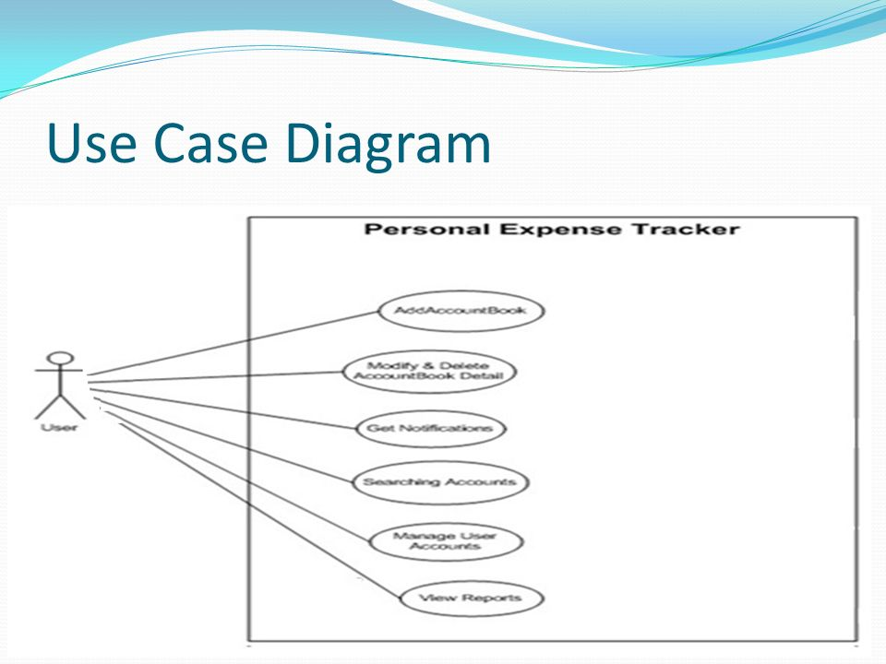
Object Oriented Diagrams (Use Case, Sequence, Activity, Class, Flow - whichever is applicable)

Slide 12
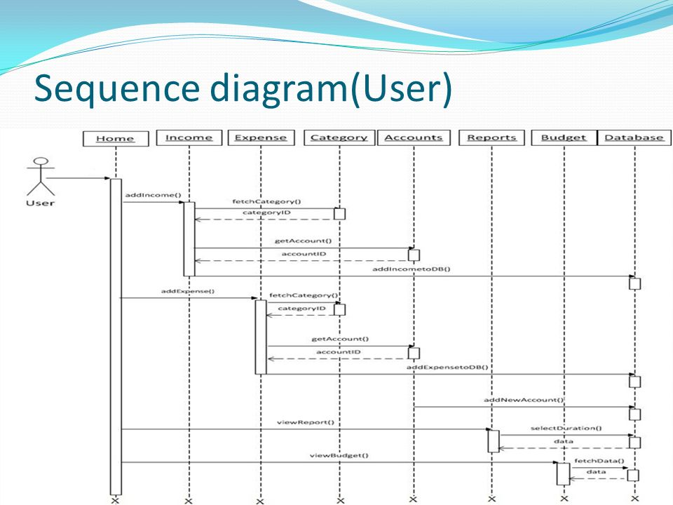
Object Oriented Diagrams (Use Case, Sequence, Activity, Class, Flow - whichever is applicable)

Slide 13






Tools & Technologies used

Slide 14
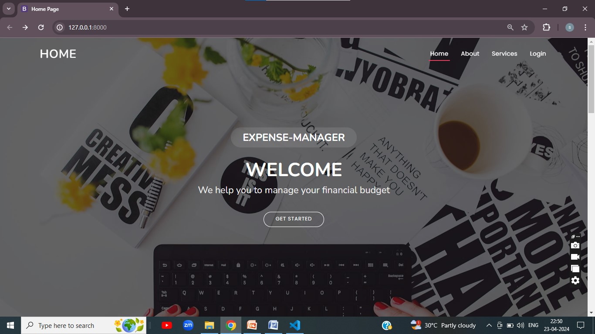
Worked carried out till date
Home Page

Slide 15
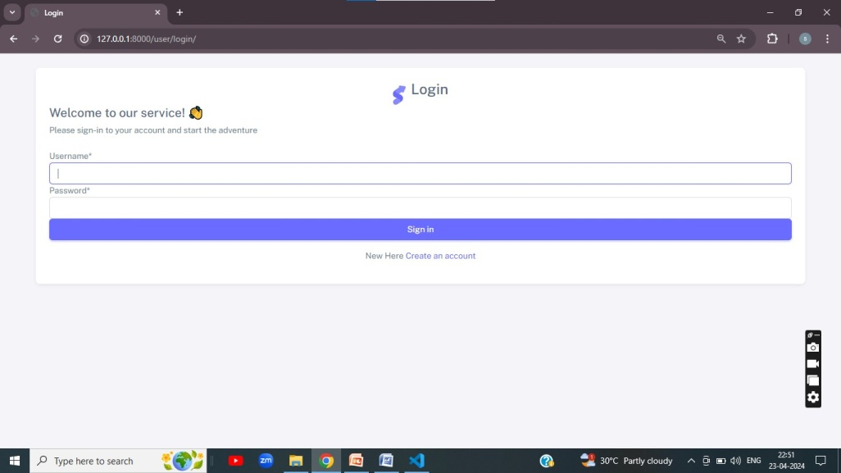
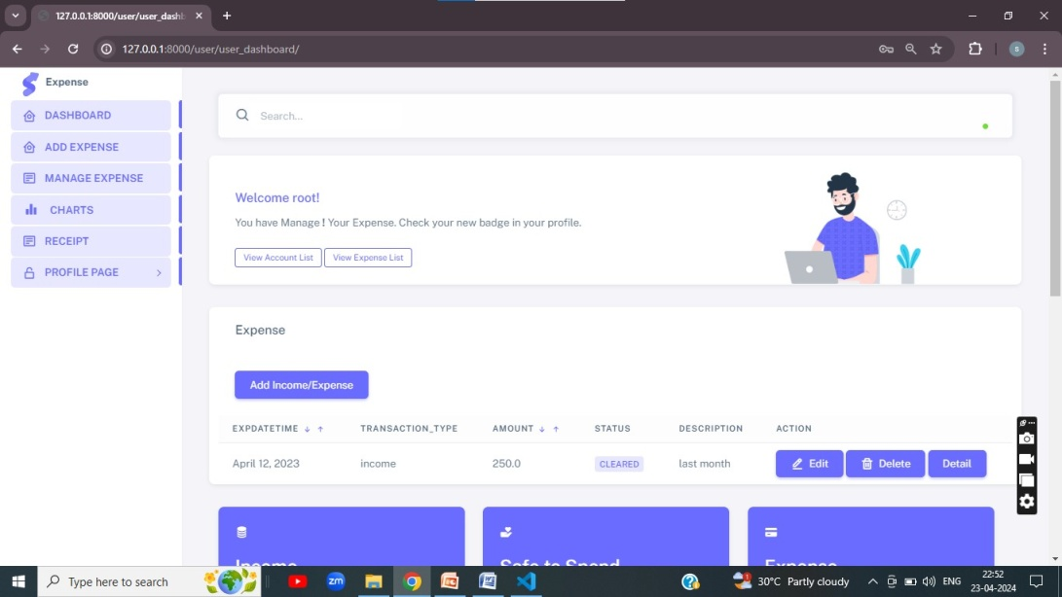
Worked carried out till date
Registration Page
User Dashboard

Slide 16
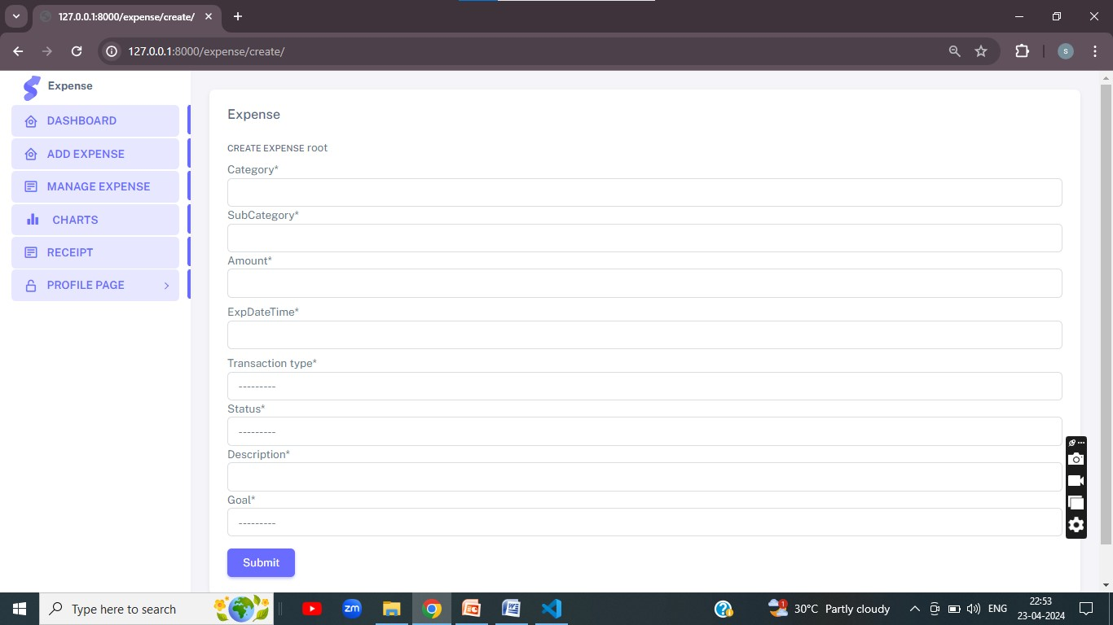
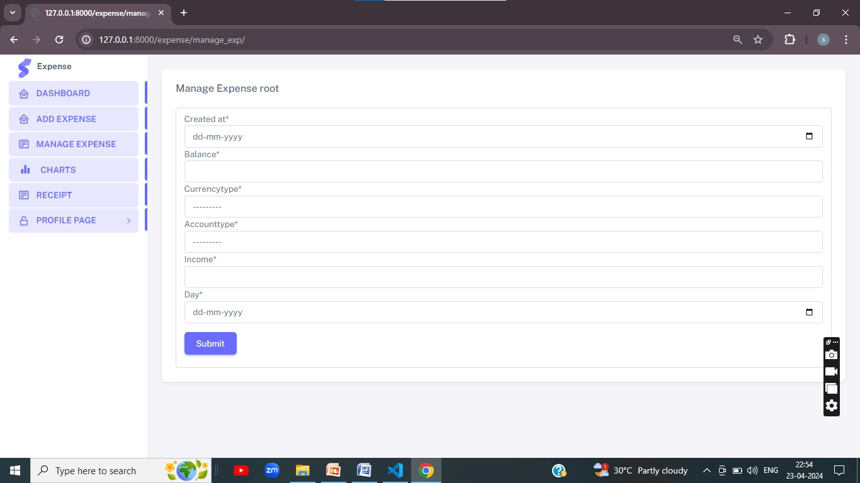
Worked carried out till date
Expense Creation Page
Income Management Page

Slide 17
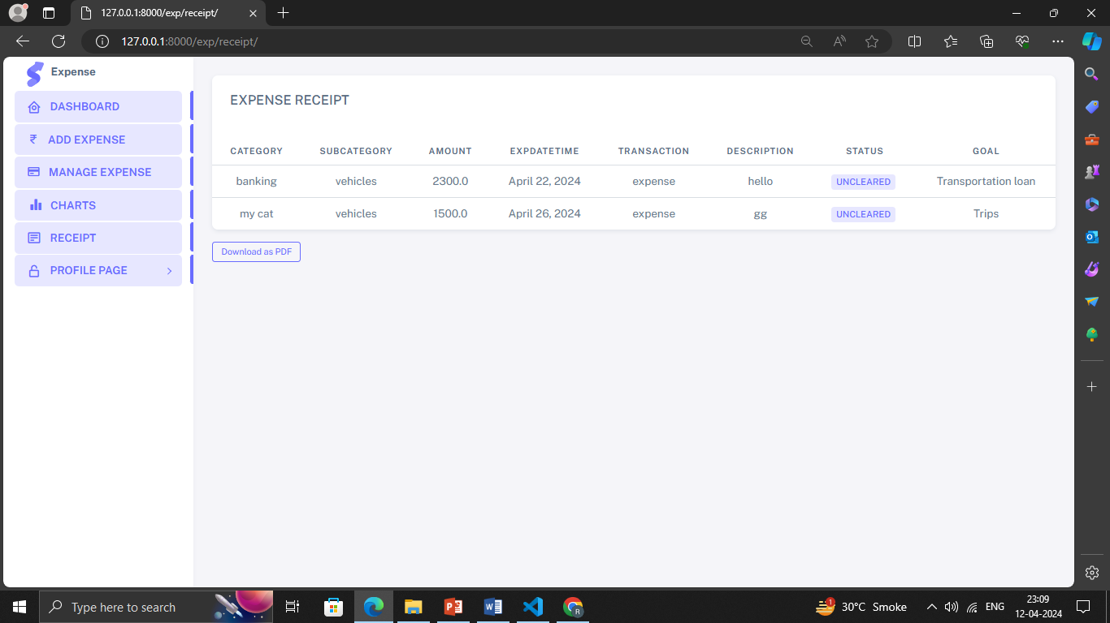
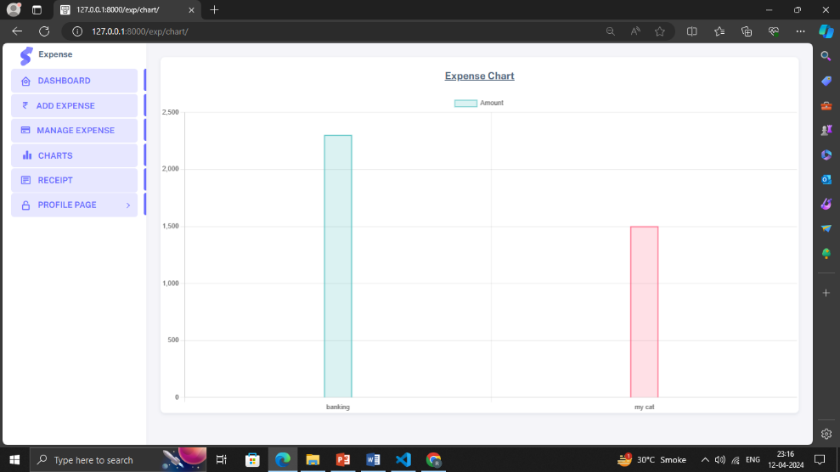
Worked carried out till date
Expense Receipt Page
Expense Chart Page

Slide 18
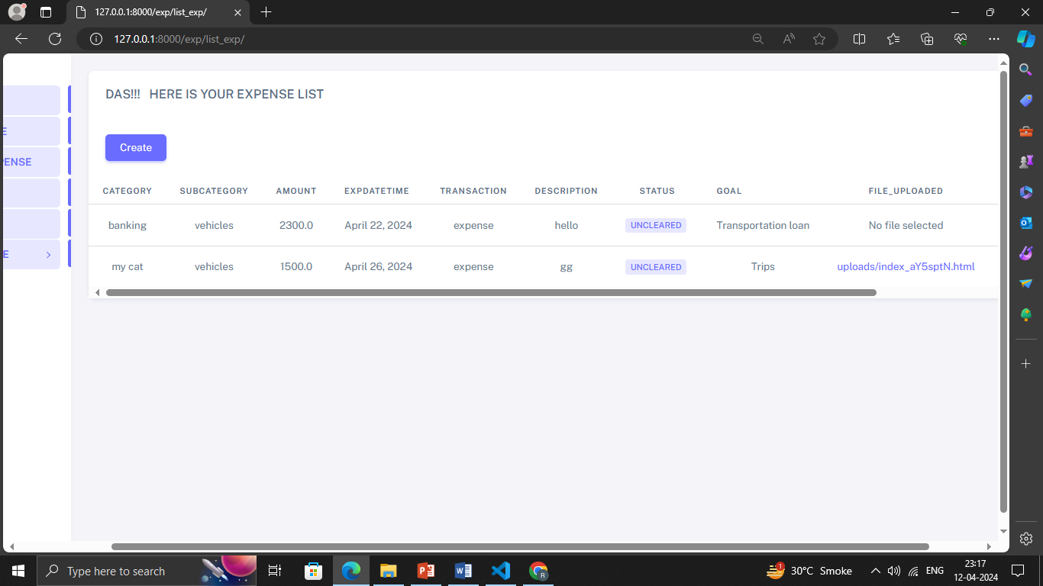
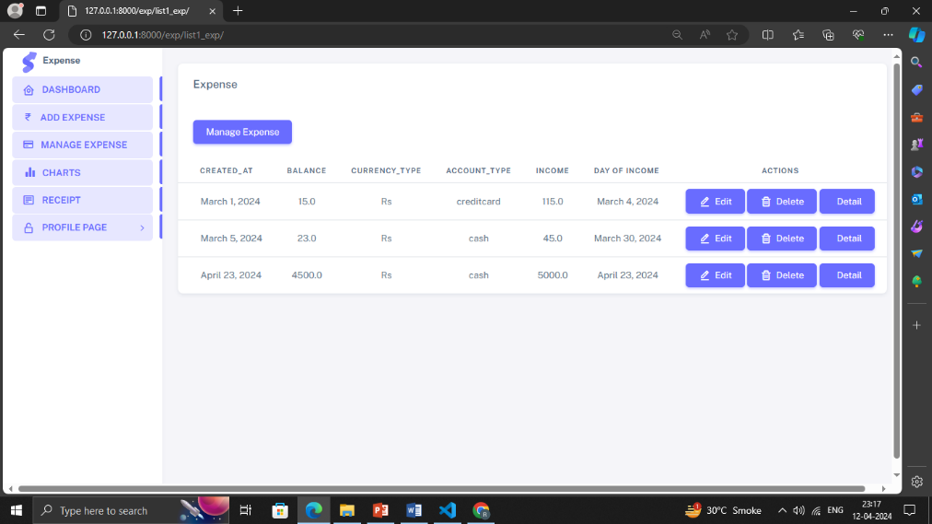
Worked carried out till date
Expense List
Income List

Slide 19
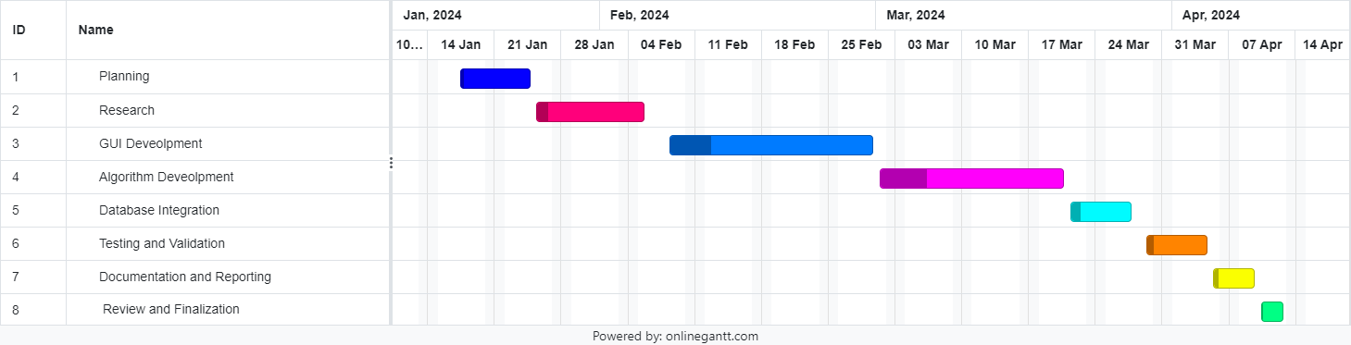
Timeline Chart(Gantt chart)

Slide 20
Future Work
Future work in expense manager websites could focus on several areas to further enhance their functionality, usability, and effectiveness. Here are some potential avenues for future development:-
Integration of artificial intelligence (AI) and machine learning algorithms to automate expense categorization, receipt parsing, and anomaly detection, further reducing manual effort and improving accuracy.
Implementing predictive analytics capabilities to forecast future expenses based on historical data, helping users anticipate upcoming costs and better plan their budgets.
Exploring block chain technology for secure and tamper-proof recording of transactions, enhancing transparency, and trust in expense tracking and auditing processes.
Integrating with financial wellness platforms or personal finance management tools to provide users with holistic insights into their financial health, including savings goals, investment portfolios, and debt management.
By focusing on these areas for future development, expense tracker websites can continue to evolve and meet the evolving needs of users.

Slide 21
Conclusion
After diligent development and thorough testing, we are pleased to announce the successful completion and deployment of our “Expense Tracker Website”.
The project has been meticulously crafted to meet the specified requirements, and we're proud to declare it free of any discernible bugs or errors according to our stringent testing standards. Our journey with this project, titled 'Expense Tracker ', has been both enriching and rewarding.
As we reflect on our accomplishments, we recognize that this is merely the beginning of a much larger endeavor. Just as every successful journey marks the start of a new path, our completion of this project opens doors to further exploration and the pursuit of new goals.
By centralizing expense tracking, automating manual processes, and providing insightful analytics, these platforms empower users to gain better control over their finances, identify spending patterns, and make informed decisions to achieve their financial goals. Moreover, the user experience and adoption strategies are vital aspects that contribute to the success of expense tracker websites, ensuring that users find the platforms intuitive, valuable, and easy to adopt.

Slide 22
References
https://www.python.org/downloads/
https://stackoverflow.com/questions/3916191/download-data-url-file
https://www.postgresql.org/download/
https://www.djangoproject.com/download/
https://www.mysql.com/downloads/
https://www.sqlite.org/download.html

Slide 23
Thank You..!

